Slide 1
Building Big Architecture
Ramit Surana
@ramitsurana
ramitsurana@gmail.com

Slide 2
Agenda
Why is this important ?
Defining SOA
What are Monoliths ?
What are Microservices ?
About Docker
Principles of Microservices
Refactoring
12 Factor App
Conway's Law
Coupling
Case Studies

Slide 3
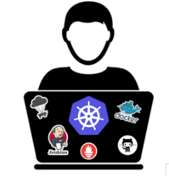
About Me
Open Source Guy
Contributor to Docker, CoreOS and Kubernetes community.
Open Source community speaker.
Contact me:
ramitsurana@gmail.com

Slide 4
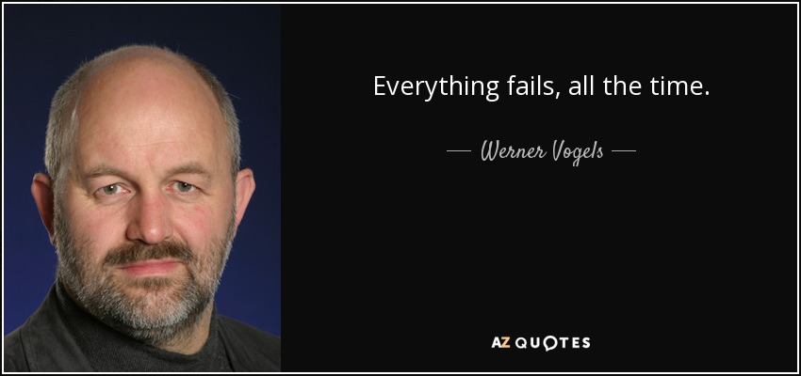
Important Sayings

Slide 5
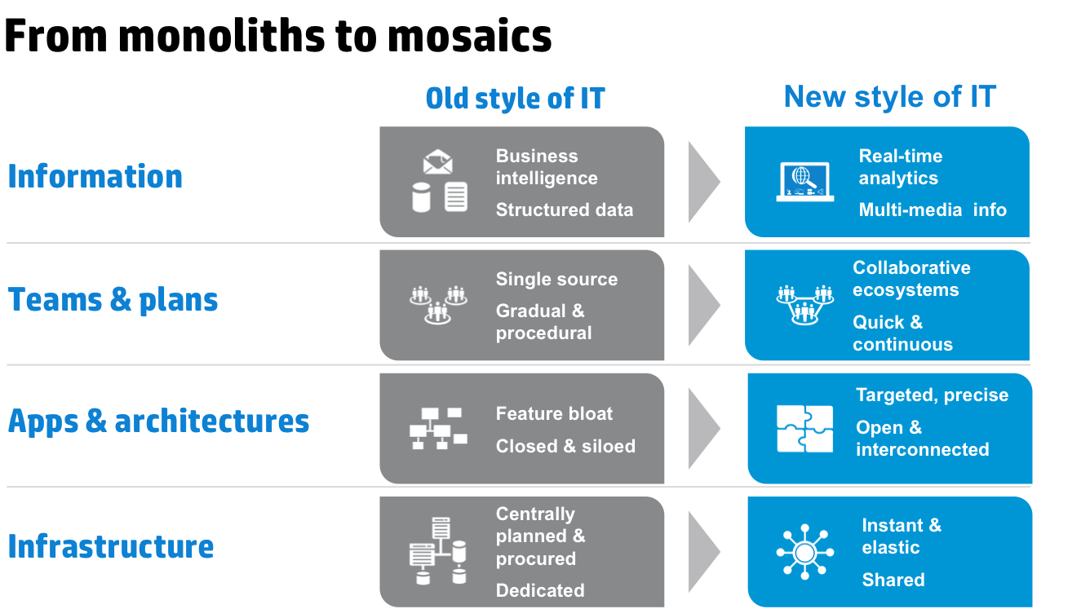
Why is this important ?

Slide 6
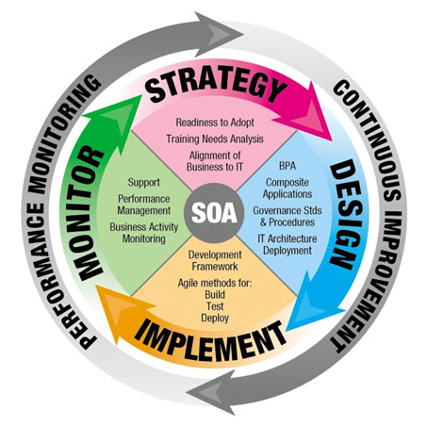
SOA(Service Oriented Architecture)
Architectural pattern in computer software design in which application components provide services to other components via a communications protocol, typically over a network.

Slide 7
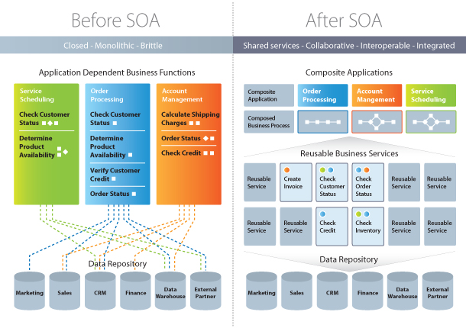
Before and After SOA

Slide 8
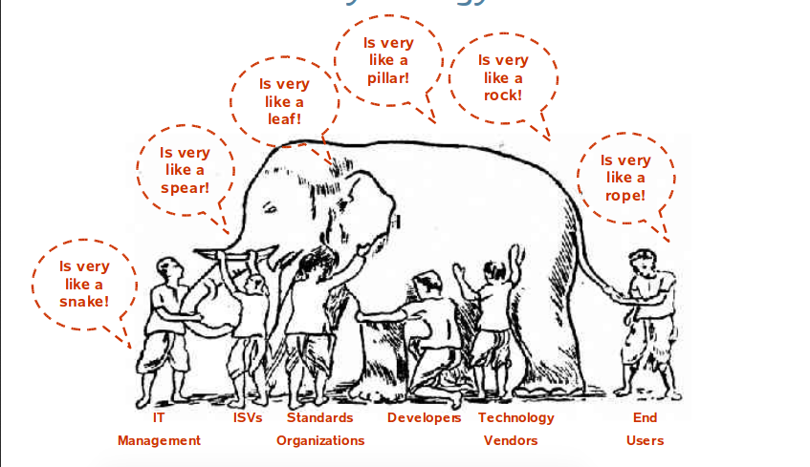
SOA Mythology

Slide 9
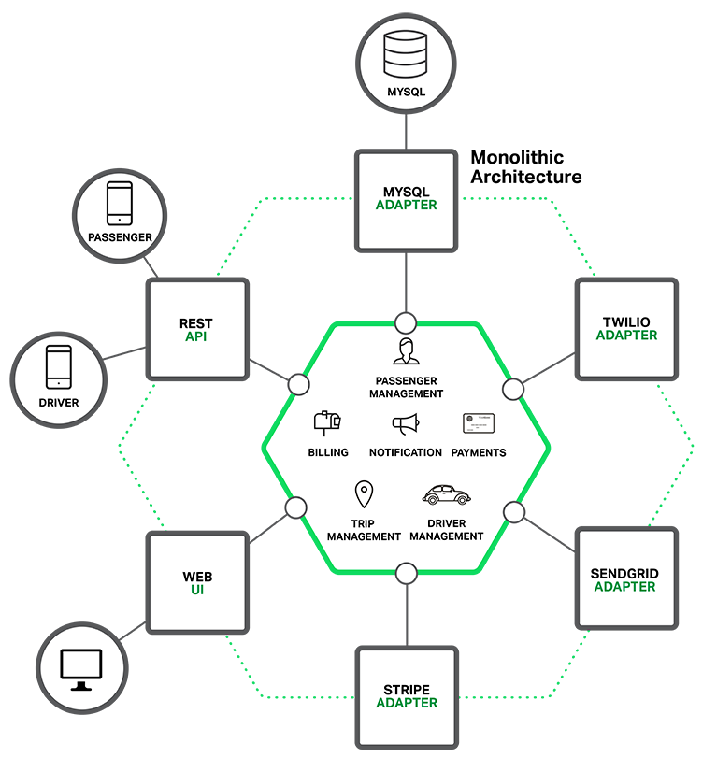
Overview of Monolith Architecture

Slide 10
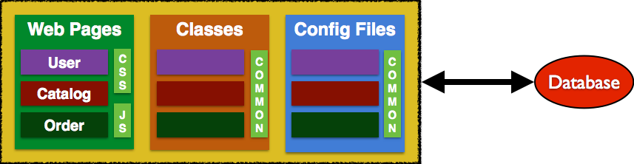
Monolithics
Single Runtime
Single Codebase
Layered architecture
Initialization of the system may be tricky or laborious.
Change to the control flow is impossible.
An application where all of the logic runs in a single app server.

Slide 11
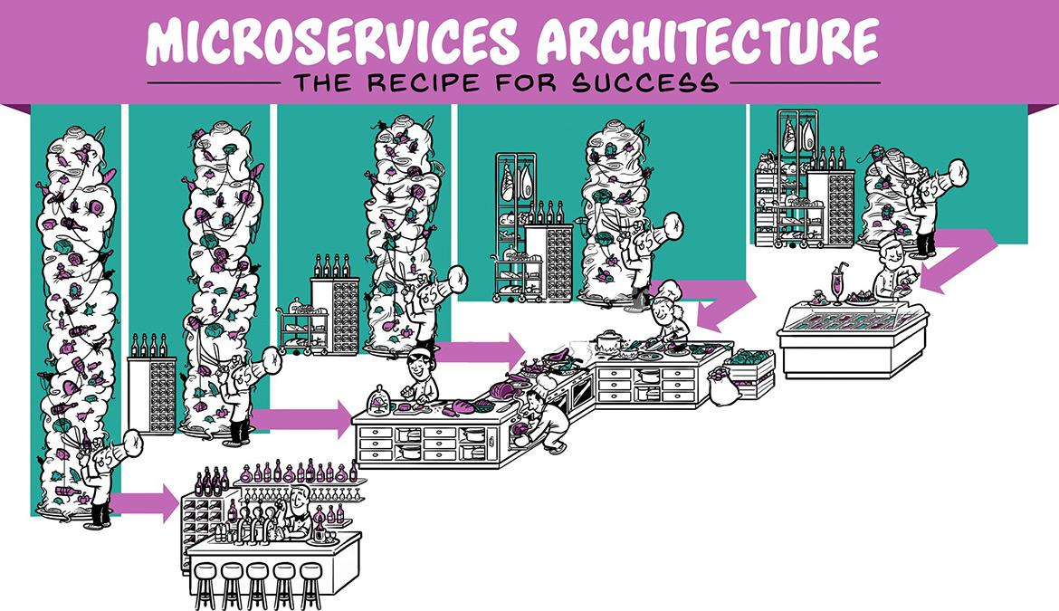
Microservices

Slide 12
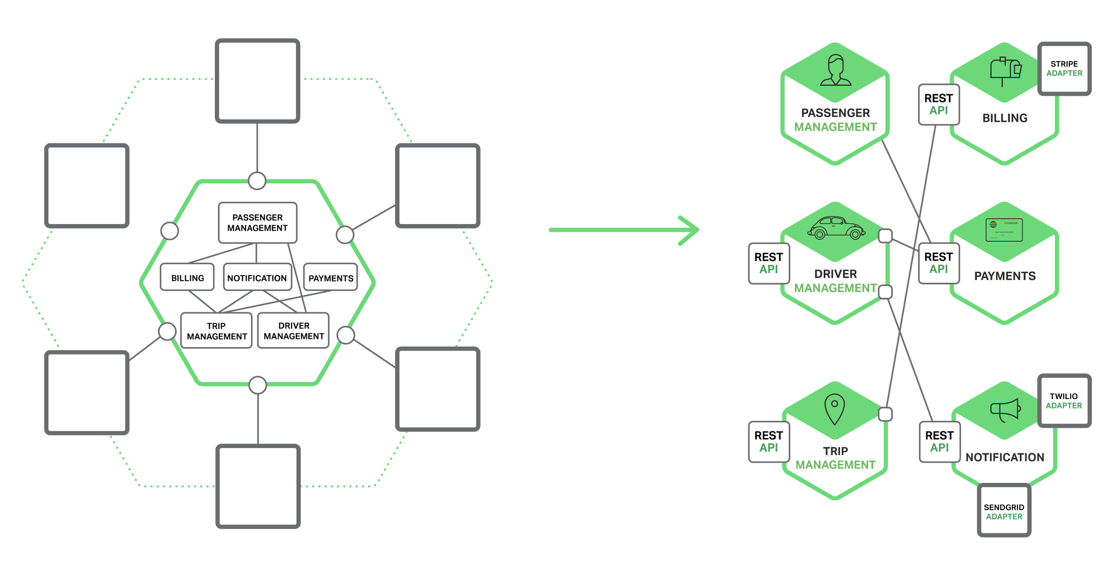
Overview of Microservices Architecture

Slide 13
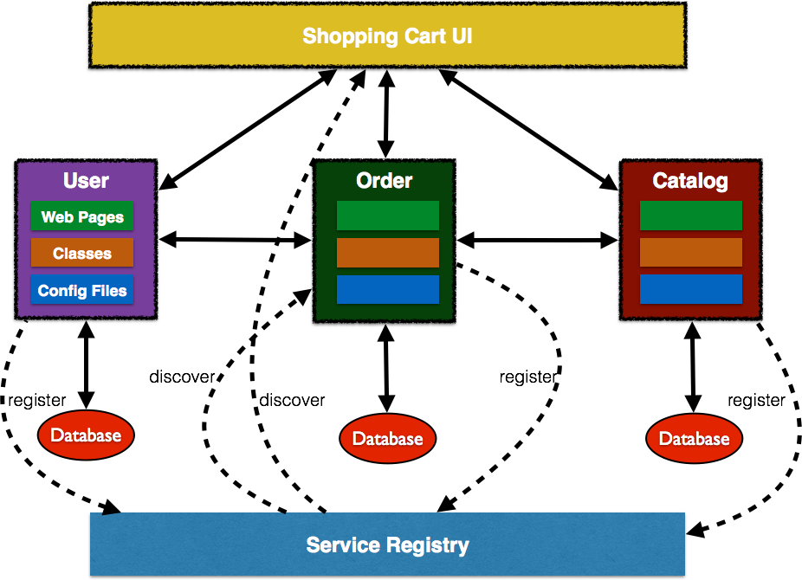
Microservices
Loosely coupled service oriented architecture with bounded contexts.
Design for failure
Decentralized Governance
Decentralized Data Management.
Componentization via Services

Slide 14
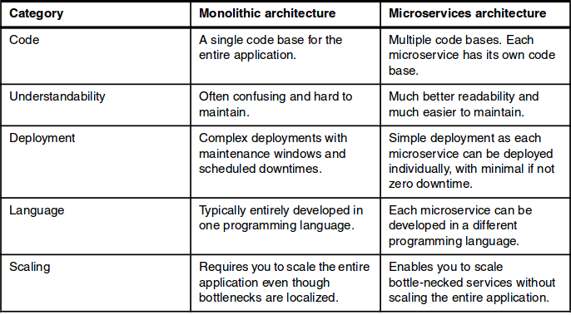
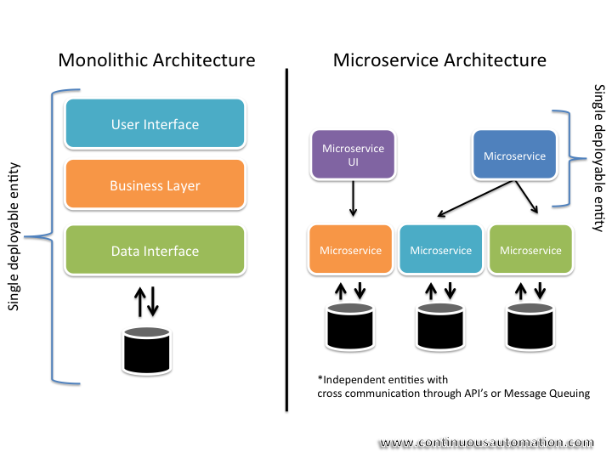
Microservices vs Monolithic

Slide 15
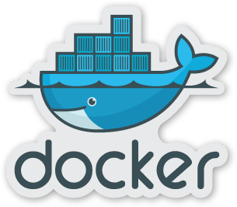
About Docker
Open platform for developers and sysadmins to build, ship, and run distributed applications.
Docker enables apps to be quickly assembled from components.
It eliminates the friction between development, QA and production environments.

Slide 16
The Problem

Slide 17
Using Monolithic
Developer
Java
Release Cycles
Production
Developer
Java
Developer
Java
Developer
Java
Developer
Java

Slide 18
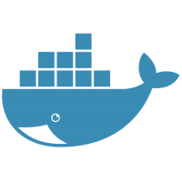
Using Microservices
Developer
Redis
Developer
Golang
Developer
NodeJS
Release
Cycles
Production
Developer
Java
Developer
Php

Slide 19
Using Docker Hub with Microservices
Developer
Configure
Developer
Configure
Docker
Hub
Developer
Configure
Release
Cycles
Production
Developer
Configure
Developer
Configure

Slide 20


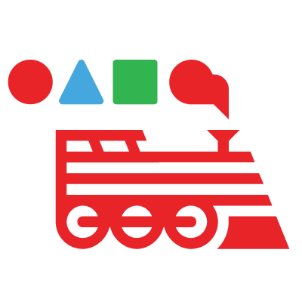

Using PaaS
Orchestration Engine
Developer
PaaS
Configure
Developer
Configure
Docker
Hub
Developer
Configure
Release
Cycles
Production
Developer
Configure
Developer
Configure

Slide 21
Principles Governing Micro services

Slide 22
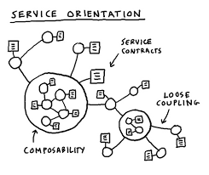
Coupling
Tight coupling leads to huge, monolithic systems that are difficult to maintain or improve upon
If changing one module in a program requires changing another module, then coupling exists.

Slide 23
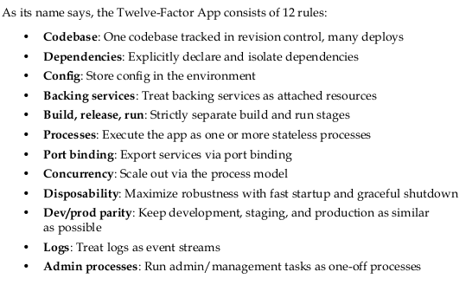
12 Factor app

Slide 24
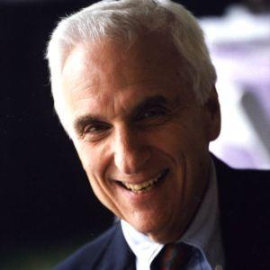
Conway's Law
"Any organization that designs a system … will inevitably produce a design whose structure is a copy of the organization's communication structure."

Slide 25
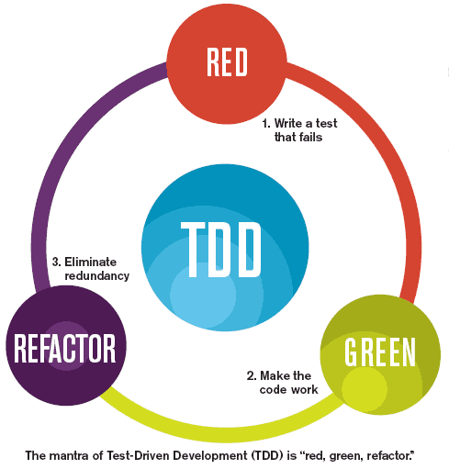
Refactoring
Process to change the existing code without changing its external behavior.
Refactoring improves nonfunctional attributes of the software.

Slide 26
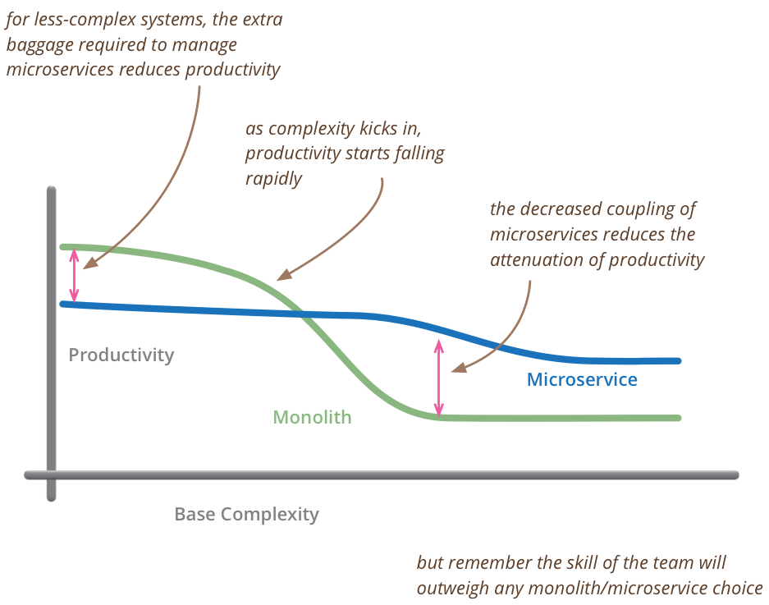
Comparison of performance

Slide 27
But What about DevOps ?

Slide 28
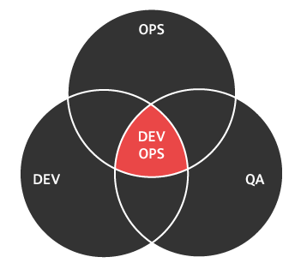
DevOps
DevOps is a company culture where the Developers movement or practice emphasizes the collaboration and communication of both software developers and other information-technology (IT) professionals.
It helps in automation and making delivery fast.

Slide 29
Case Studies

Slide 30
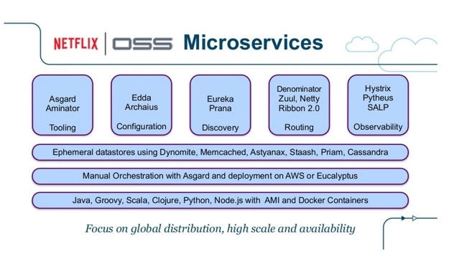
How Netflix does it?

Slide 31
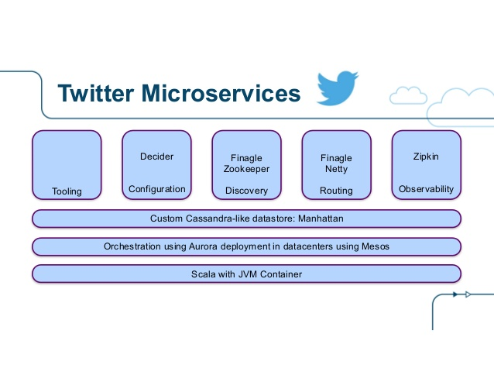
How Twitter do it?

Slide 32
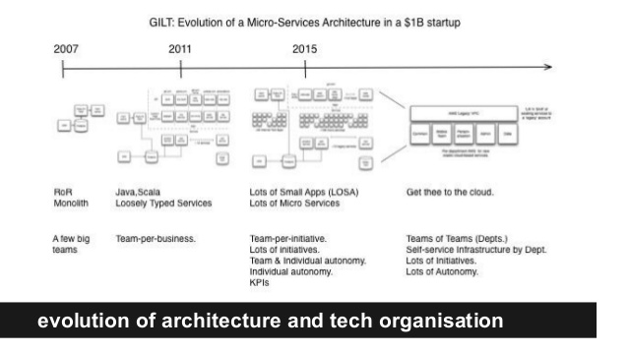
How Gilt does it?

Slide 33
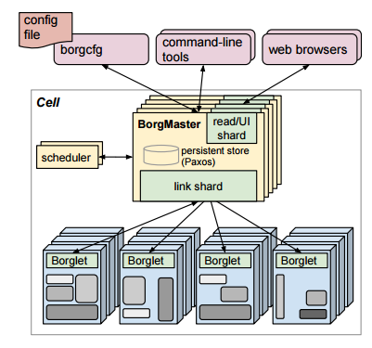
How does Google does it?

Slide 34

Any Questions?

Slide 35
Thank You
May you have an awesome day ahead !

